Slide 1
Package Manager
Don’t be fooled!

Slide 2
“ I think that proposed reduction is ready to rate and finalize the reduction. The due process letter is in the file. It’s even dated and everything!”
BUT, did that letter REALLY get sent to the veteran/claimant?

Slide 3
Using Package Manager
When creating packages using Package Manager for centralized printing, you must follow the guidance provided in the ‘Tips for Using Centralized Printing Successfully’ (M21-1 I.1.B, M21-1 III.v.2.B, and M21-1 III, ii.1.B). Ref; July 2020 Compensation Service Quality Call Bulletin

Slide 4
Most problems seem to be caused by due process letters required for ratings proposing reduction or severance.

Slide 5
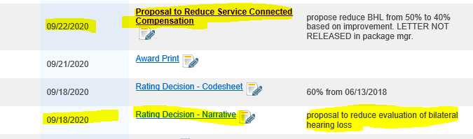
VBMS Documents Screen shows the due process notification letter:

Slide 6
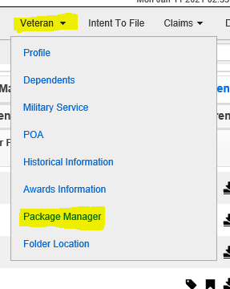
Where Do I Find Package Manager In The Claim File?

Slide 7
How do I verify the letter was sent?

Slide 8
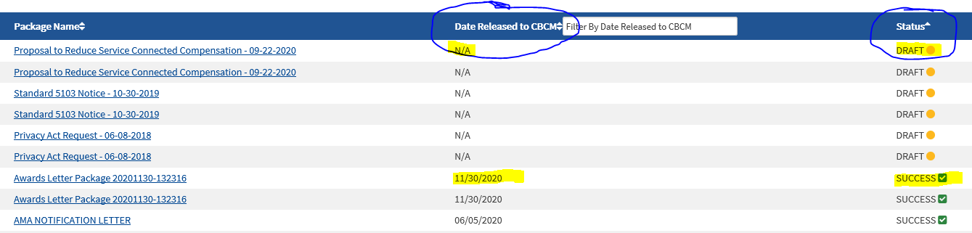
Pay Close Attention to Package Manager Status in the Distributions tab.

Slide 9
If Package Manager shows the status as draft, instead of success, the letter HAS NOT been sent, even though there is a dated due process letter in the documents screen of the claim file.
Don’t be fooled by only looking at the documents screen!

Slide 10
How can I see if the package was finalized?

Slide 11
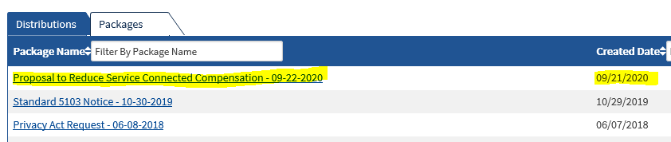
Packages tab left side shows:

Slide 12
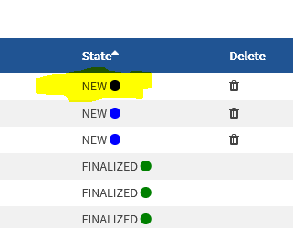
Far right side of Packages tab shows the package is in a “new” state, and hasn’t been finalized.

Slide 13
The claim is not ready for decision because the veteran/claimant has not been properly notified.
Return the claim for proper due process notification in package manager.

